Slide 1
Leaf Growth

Slide 2
Brainstorm
up/down scrolling treelike structure
Data, roots, plant
User interaction
character creator
Take in JSON data
Get data from visual turing pattern, analyze it
How does average color (or smth else) fluctuate?
What if we generate sound from it?
Game with audio input
Match pattern
Sine wave stability changes are like seasons
Overpopulation causes reduction in population

Slide 3
Description
This project uses a modified reaction-diffusion to create leaf shapes, with branching somewhat similar to leaf veins. The most notable functional changes are:
No decay, meaning all growth is permanent
An upwards-directed force to encourage growth in 1 direction.
Decreasing diffusion1 rate over time, to produce smaller veins further out.
There are also aesthetic changes to more resemble a leaf, and the above functionalities can also be controlled through new slider parameters.
I’ve been interested in procedural plant growth for a while, as one thing I feel modern 3D software lacks is good, easy-to-use procedural plants. They tend to have too many parameters and still look bad. So, while this leaf-generation program is not 3D, or very accurate, it was an exploration into procedural plants.

Slide 4
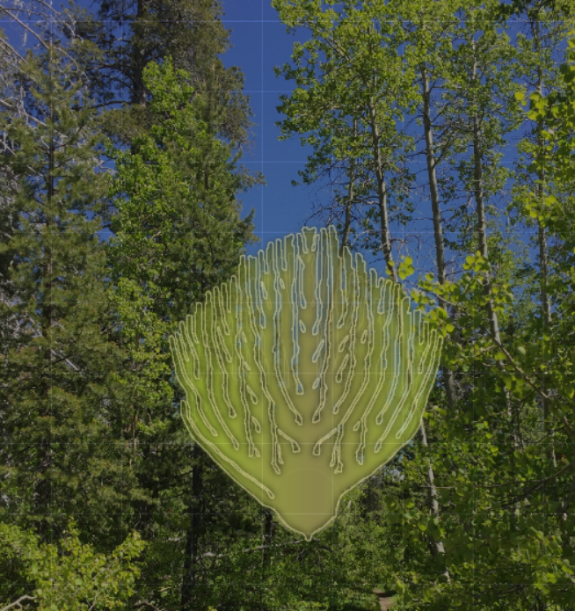
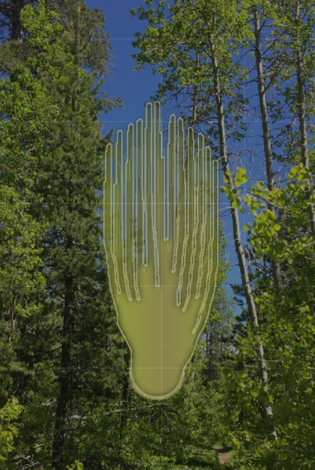

Slide 5
Sources and Resources
Informational site about audio waveforms
Converting an image into audio in TouchDesigner
GLSL Gaussian Blur shader
HDRI Haven - HDRI textures
None of these are used in the final result, but I experimented with all of them in the project.

